Slide 1
Change
Change in information systems refers to any alteration or transformation in the technology, processes, or methodologies used within an organization.
This could involve updates to software, hardware, or network infrastructure, modifications to business processes supported by information systems, or shifts in the way data is managed and utilized.

Slide 2
Change Management
Change management in information systems is the structured approach and set of processes for managing changes to ensure they are implemented smoothly and successfully, with minimal disruption to the organization.
It involves planning, executing, and monitoring changes while addressing the human and technical aspects to ensure acceptance and effectiveness.

Slide 3
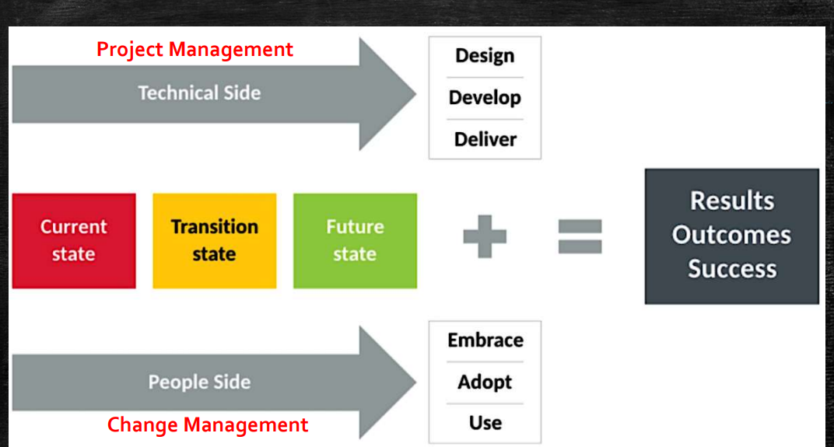

Slide 4
Project Management
Purpose:
Objective: Project management focuses on achieving specific objectives within a defined scope, budget, and timeline.
End Result: It is primarily concerned with delivering a unique product, service, or result that meets predefined criteria and satisfies stakeholder expectations.
Focus:
Scope: Project management involves managing tasks, resources, timelines, and budgets to complete the project deliverables.
Execution: It emphasizes planning, organizing, and coordinating resources (people, equipment, materials) to execute tasks and achieve project goals efficiently.
Characteristics:
Structured Approach: Project management follows a structured methodology (e.g., Agile, Waterfall) with defined phases (initiation, planning, execution, monitoring, closing).
Measurable Outcomes: Success is often measured by deliverables completed on time, within budget, and meeting quality standards.
Examples:
Examples: Developing a new software application, constructing a building, organizing an event, or implementing a marketing campaign.

Slide 5
Change Management
Purpose:
Objective: Change management focuses on guiding individuals, teams, and organizations through transitions to achieve desired outcomes from a change initiative.
End Result: It aims to ensure that changes are implemented successfully, adoption is maximized, and desired benefits are realized.
Focus:
People and Culture: Change management centers on addressing the human side of change, including managing resistance, communication, and stakeholder engagement.
Behavioral Change: It emphasizes helping individuals and teams adapt to new processes, systems, roles, and ways of working.
Characteristics:
Adaptive Approach: Change management utilizes strategies and techniques to facilitate smooth transitions, minimize disruptions, and maintain productivity during change.
Continuous Engagement: It involves ongoing communication, training, and support to ensure stakeholders understand, accept, and embrace the change.
Examples:
Examples: Implementing a new organizational structure, adopting a new technology platform, transitioning to new business processes, or merging with another company.

Slide 6
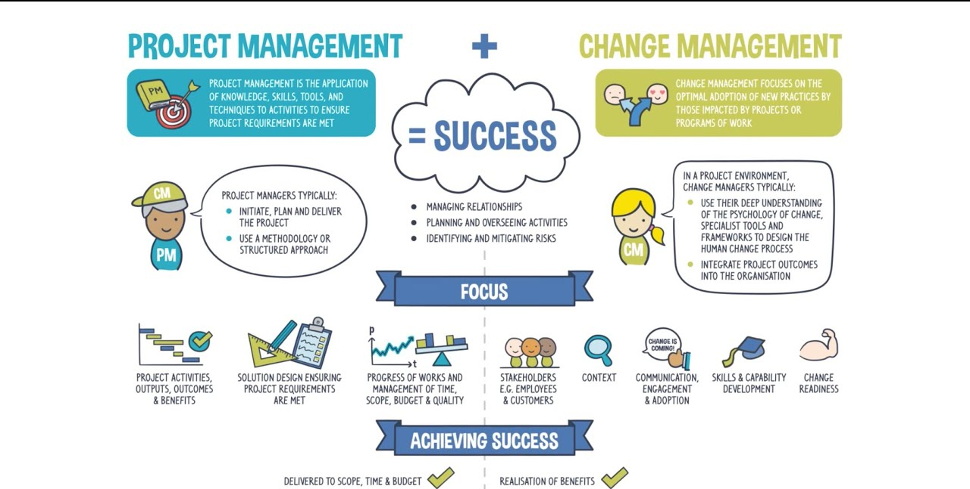

Slide 7
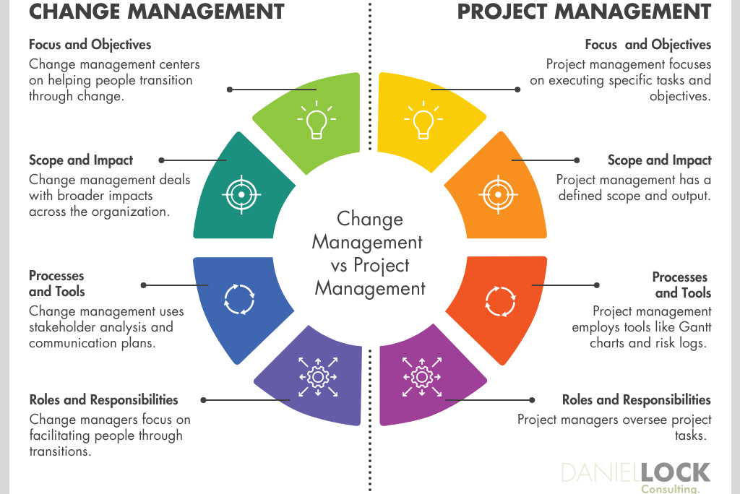

Slide 8
Change Management
Key Elements of Change Management:
Identifying the Need for Change:
Organizations typically initiate change due to factors such as technological advancements, market shifts, regulatory requirements, or strategic goals.
Planning and Preparation:
Assessment: Conducting a thorough analysis of the current state, identifying stakeholders, understanding impacts, and assessing readiness for change.
Strategy Development: Developing a change management strategy that outlines objectives, communication plans, training needs, and metrics for success.
Implementation of Change:
Communication: Effectively communicating the reasons for change, the vision of the future state, and how it will impact stakeholders.
Training: Providing training and support to equip employees with the skills and knowledge needed to succeed in the new environment.
Support: Offering ongoing support and resources to help individuals and teams navigate the change process smoothly.

Slide 9
Change Management
Managing Resistance:
Addressing Concerns: Identifying sources of resistance, addressing concerns, and involving key stakeholders in the change process to build commitment.
Feedback Mechanisms: Establishing mechanisms for gathering feedback, listening to concerns, and making adjustments as needed.
Sustaining Change:
Reinforcement: Reinforcing the change by celebrating successes, recognizing achievements, and embedding new behaviors and practices into organizational culture.
Monitoring and Evaluation: Continuously monitoring the implementation, evaluating outcomes against predefined metrics, and making refinements to ensure long-term success.

Slide 10
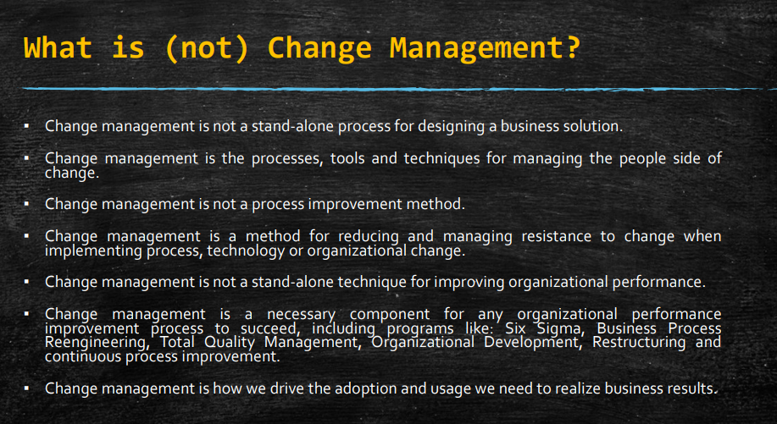

Slide 11
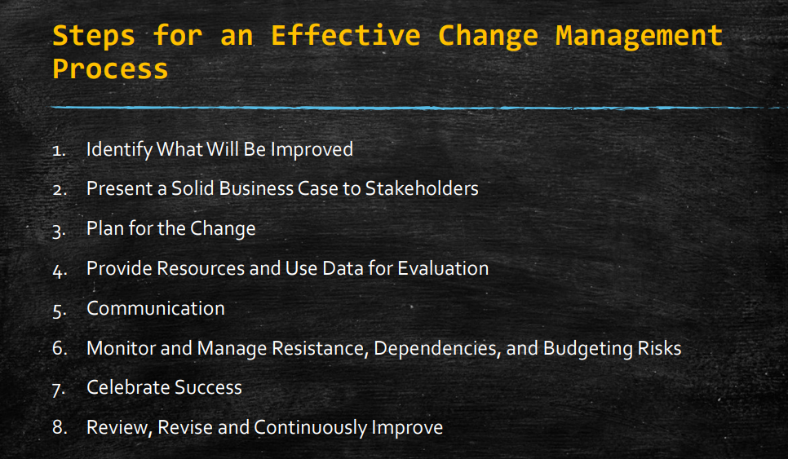

Slide 12
Types of Change within a business
1 . Strategic Changes
Strategic Initiatives: These changes involve significant shifts in an organization's mission, vision, goals, or competitive strategy. Examples include entering new markets, diversifying product lines, or restructuring the organization.
2. Structural Changes
Organizational Restructuring: Structural changes involve altering the organizational hierarchy, reporting relationships, roles, or responsibilities. This could include mergers, acquisitions, downsizing, or departmental reorganizations.
3. Technological Changes
IT Systems and Infrastructure: Technological changes involve implementing new technologies, upgrading existing systems, or adopting new software applications to enhance efficiency, productivity, and innovation.
4. Process Changes
Business Processes: Process changes focus on improving workflows, procedures, and operational efficiencies. Examples include implementing lean manufacturing principles, introducing Six Sigma methodologies, or redesigning customer service processes.

Slide 13
Types of Change within a business
5. Cultural Changes
Organizational Culture: Cultural changes involve shifting the values, beliefs, attitudes, and behaviors within an organization. This could include promoting a culture of innovation, enhancing diversity and inclusion initiatives, or fostering a customer-centric culture.
6. Personnel Changes
Human Resources: Personnel changes involve adjustments in workforce composition, skills development, and talent management strategies. Examples include hiring new talent, workforce training programs, or implementing performance management systems.
7. Product or Service Changes
Offerings and Offerings: Changes to products or services involve modifying existing offerings or launching new ones in response to market demands, technological advancements, or competitive pressures.
8. Compliance and Regulatory Changes
Legal and Regulatory: Changes involve complying with new laws, regulations, or industry standards. This could include changes in environmental regulations, data protection laws, or safety standards.

Slide 14
Types of Change within a business
9. Financial Changes
Financial Management: Changes involve adjustments in financial strategies, budget allocations, cost-cutting measures, or investment decisions to improve financial performance or respond to economic fluctuations.
10. Marketing and Sales Changes
Market Strategies: Changes involve modifying marketing campaigns, sales strategies, pricing models, or distribution channels to better reach target audiences and increase market share.
11. Customer and Stakeholder Changes
Stakeholder Relationships: Changes involve enhancing relationships with customers, suppliers, partners, or other stakeholders. This could include improving customer service processes, launching loyalty programs, or conducting stakeholder engagement initiatives.

Slide 15
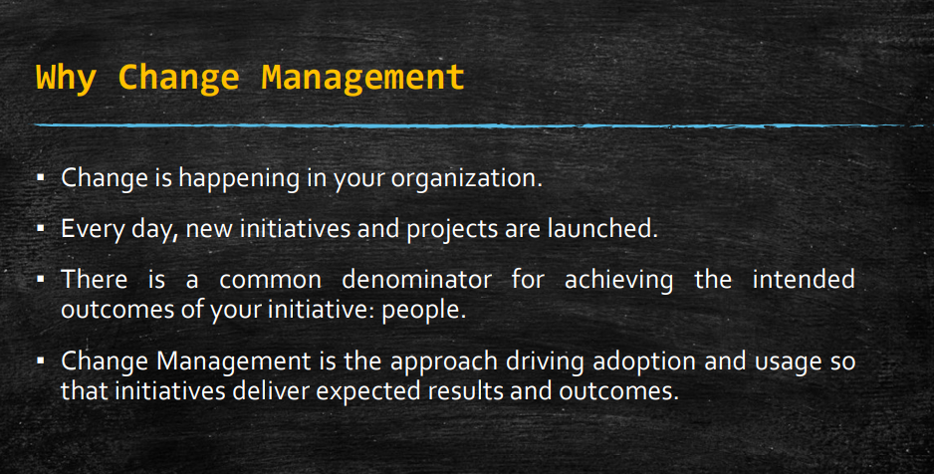

Slide 16
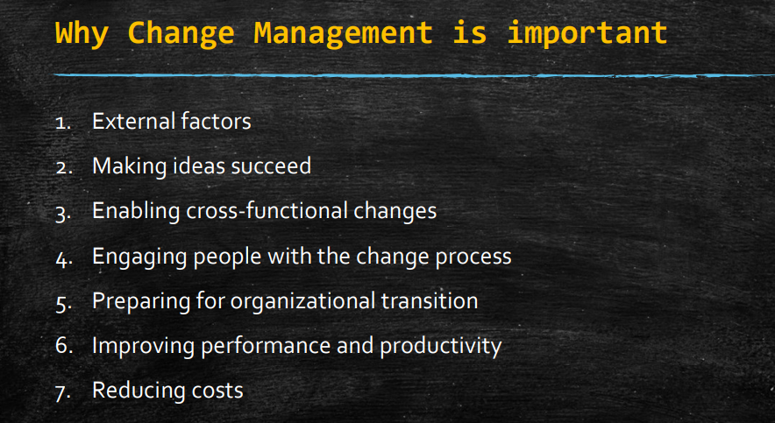

Slide 17
CSF
Critical Success Factors (CSFs) are the essential areas of activity that must be performed well for an organization to achieve its mission and goals.
They are the key areas where "things must go right" for the business to flourish and are often tied directly to the organization's strategic objectives.

Slide 18
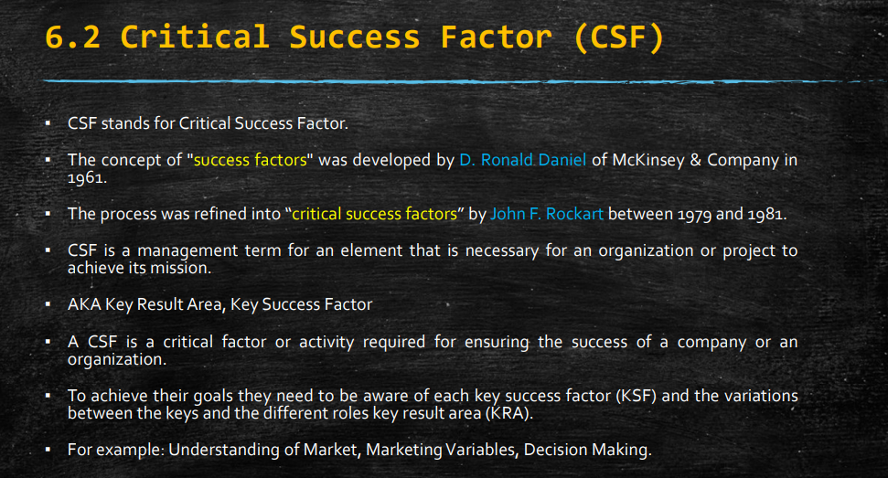

Slide 19
Characteristics of Critical Success Factors:
Vital to Success: CSFs are not optional but fundamental to achieving organizational success and competitive advantage.
Measurable: They can be quantified or evaluated to determine progress towards achieving strategic goals.
Specific: CSFs are specific to the organization's industry, market position, and strategic priorities.
Dynamic: CSFs may evolve over time as external and internal conditions change.
Limited in Number: CSFs are typically a small number of key factors that have the most significant impact on achieving objectives.

Slide 20
Example of CSFs for Everest
High-Quality Education:
Objective: Ensure the curriculum is up-to-date with industry standards and best practices.
CSF: Regularly update course content and invest in faculty development.
Actionable Step: Implement a continuous feedback loop from industry partners and alumni to inform curriculum updates.
Student Satisfaction and Success:
Objective: Achieve high levels of student satisfaction and success rates.
CSF: Provide excellent academic support and career services.
Actionable Step: Develop robust tutoring programs and career counseling services
Research and Innovation:
Objective: Establish the college as a leader in research and innovation.
CSF: Secure research funding and attract top-tier research faculty.
Actionable Step: Create grant-writing workshops and incentivize faculty publications in prestigious journals.

Slide 21
Example of CSFs for Manufacturing Company
Product Quality:
Objective: Produce high-quality products that meet or exceed customer expectations.
CSF: Implement strict quality control measures.
Actionable Step: Establish comprehensive quality assurance processes and regular audits.
Operational Efficiency:
Objective: Achieve high levels of operational efficiency to reduce costs and improve profitability.
CSF: Optimize production processes and supply chain management.
Actionable Step: Adopt lean manufacturing techniques and use advanced analytics for supply chain optimization.
Customer Satisfaction:
Objective: Maintain high levels of customer satisfaction and loyalty.
CSF: Provide excellent customer service and support.
Actionable Step: Implement a responsive customer feedback system and continuous improvement processes for customer service.

Slide 22
Challenges in Managing CSFs
Changing Priorities:
Example: Shifts in market conditions or organizational strategy can alter the importance of different CSFs.
Resource Constraints:
Example: Limited budget or personnel can hinder the ability to focus adequately on all CSFs.
Measurement Difficulties:
Example: Some CSFs may be difficult to measure directly, making it hard to track progress.
Resistance to Change:
Example: Employees and stakeholders may resist changes needed to focus on new or evolving CSFs.

Slide 23
Classification of CSFs
Critical Success Factors (CSFs) can be classified into primary and secondary categories based on their direct impact on achieving the organization's strategic objectives.
Primary CSFs are essential elements that have a direct and significant impact on success, while secondary CSFs support and enhance the primary factors but are not as critical on their own.
Classification of CSFs
1. Primary CSFs: Primary CSFs are the core elements that must be achieved for an organization to reach its strategic goals. They have the most significant impact on the success of the organization and typically align closely with the mission and vision.
2. Secondary CSFs: Secondary CSFs are important but play a supporting role. They enhance the effectiveness of the primary CSFs but do not directly impact the core mission or strategic objectives to the same extent.

Slide 24
Engineering College (Everest Engineering College) Primary CSFs:
High-Quality Education:
Objective: Ensure the curriculum is up-to-date with industry standards and best practices.
Example: Regularly updating course content and investing in faculty development to provide cutting-edge education.
Impact: Directly influences the college’s reputation and student success rates.
Student Satisfaction and Success:
Objective: Achieve high levels of student satisfaction and success rates.
Example: Providing excellent academic support and career services to ensure students are well-prepared for their careers.
Impact: Directly affects student retention, graduation rates, and the overall reputation of the institution.
Research and Innovation:
Objective: Establish the college as a leader in research and innovation.
Example: Securing research funding and attracting top-tier research faculty to drive groundbreaking research.
Impact: Enhances the institution's prestige and attracts top talent and funding.

Slide 25
Secondary CSFs:
Administrative Efficiency:
Objective: Streamline administrative processes to improve operational efficiency.
Example: Implementing an efficient student information system (SIS) to handle administrative tasks.
Impact: Supports primary CSFs by freeing up resources and reducing bureaucratic overhead.
Alumni Engagement:
Objective: Maintain strong relationships with alumni for support and networking opportunities.
Example: Creating alumni programs and networks to keep alumni engaged with the college.
Impact: Provides additional resources and networking opportunities, enhancing primary CSFs indirectly.
Technological Infrastructure:
Objective: Ensure robust and reliable IT systems to support educational and research activities.
Example: Upgrading campus Wi-Fi and ensuring high availability of online resources.
Impact: Supports primary CSFs by providing the necessary technological backbone for educational excellence.

Slide 26
Manufacturing Company Primary CSFs:
Product Quality:
Objective: Produce high-quality products that meet or exceed customer expectations.
Example: Implementing strict quality control measures throughout the production process.
Impact: Directly affects customer satisfaction and brand reputation.
Operational Efficiency:
Objective: Achieve high levels of operational efficiency to reduce costs and improve profitability.
Example: Adopting lean manufacturing techniques to streamline production processes.
Impact: Directly influences the company's bottom line and competitive advantage.
Customer Satisfaction:
Objective: Maintain high levels of customer satisfaction and loyalty.
Example: Providing excellent customer service and support to ensure a positive customer experience.
Impact: Directly impacts sales, repeat business, and market share.

Slide 27
Secondary CSFs:
Supply Chain Management:
Objective: Ensure a reliable and cost-effective supply chain.
Example: Establishing strong relationships with suppliers to ensure timely delivery of materials.
Impact: Supports primary CSFs by ensuring smooth production processes and reducing downtime.
Employee Training and Development:
Objective: Continuously improve the skills and capabilities of employees.
Example: Offering regular training programs and professional development opportunities.
Impact: Enhances operational efficiency and product quality indirectly by improving employee performance.
Regulatory Compliance:
Objective: Ensure all operations meet regulatory standards and requirements.
Example: Implementing comprehensive compliance programs to adhere to industry regulations.
Impact: Supports primary CSFs by avoiding legal issues and ensuring smooth operations.

Slide 28
Summary
Primary CSFs:
Directly impact the achievement of strategic objectives.
Core to the organization's success.
Examples: High-quality education, product quality, operational efficiency.
Secondary CSFs:
Support and enhance primary CSFs.
Important but not critical on their own.
Examples: Administrative efficiency, supply chain management, employee training.

Slide 29
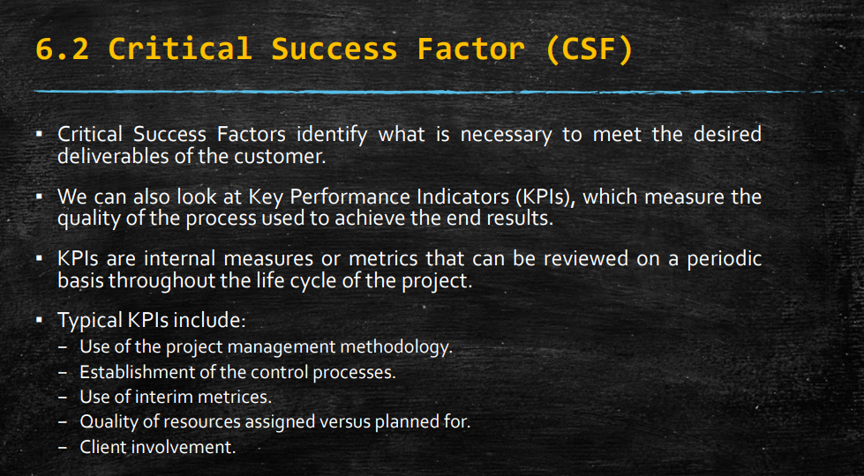

Slide 30
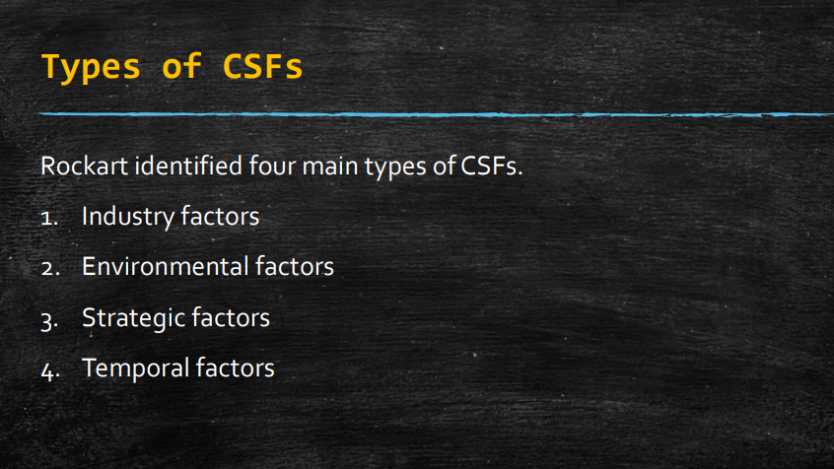

Slide 31
Types of CSFs
Critical Success Factors (CSFs) can be categorized into different types based on their focus and relevance to achieving organizational objectives. Here are several types of CSFs commonly identified in various industries and contexts:
1. Industry-Specific CSFs
Examples: These are factors that are unique to a particular industry or sector. For example, in the automotive industry, CSFs may include vehicle safety, design innovation, supply chain efficiency, and regulatory compliance with environmental standards.
2. Market Positioning CSFs
Examples: Factors related to how well an organization competes in its market segment. This could include brand recognition, customer loyalty, pricing strategy, market share growth, and distribution channel effectiveness.
3. Operational CSFs
Examples: Factors critical for efficient and effective operational performance. This could include inventory management, production cycle times, quality control processes, capacity utilization, and supply chain management.

Slide 32
Types of CSFs
4. Financial CSFs
Examples: Factors related to financial health and performance. This could include profitability margins, cash flow management, return on investment (ROI), cost management, and financial stability.
5. Technological CSFs
Examples: Factors related to technological capabilities and innovation. This could include R&D investment, technological infrastructure, IT systems integration, digital transformation initiatives, and cybersecurity measures.
6. Customer-Related CSFs
Examples: Factors critical for maintaining customer satisfaction and loyalty. This could include product/service quality, customer service responsiveness, personalized customer experiences, complaint resolution times, and customer retention rates.

Slide 33
Types of CSFs
6. Customer-Related CSFs
Examples: Factors critical for maintaining customer satisfaction and loyalty. This could include product/service quality, customer service responsiveness, personalized customer experiences, complaint resolution times, and customer retention rates.
7. Employee-Related CSFs
Examples: Factors related to workforce engagement, skills development, and organizational culture. This could include employee training programs, leadership development, employee satisfaction surveys, talent retention strategies, and workplace diversity initiatives.
8. Strategic CSFs
Examples: Factors essential for achieving long-term strategic goals. This could include strategic planning effectiveness, competitive positioning strategies, strategic alliances/partnerships, mergers and acquisitions integration, and market expansion initiatives.
9. Risk-Related CSFs
Examples: Factors critical for managing and mitigating risks. This could include risk assessment processes, compliance with regulatory requirements, crisis management plans, business continuity strategies, and insurance coverage.
10. Environmental and Social CSFs
Examples: Factors related to environmental sustainability, corporate social responsibility (CSR), and ethical business practices. This could include environmental impact reduction, community engagement initiatives, ethical sourcing practices, and diversity and inclusion policies.

Slide 34
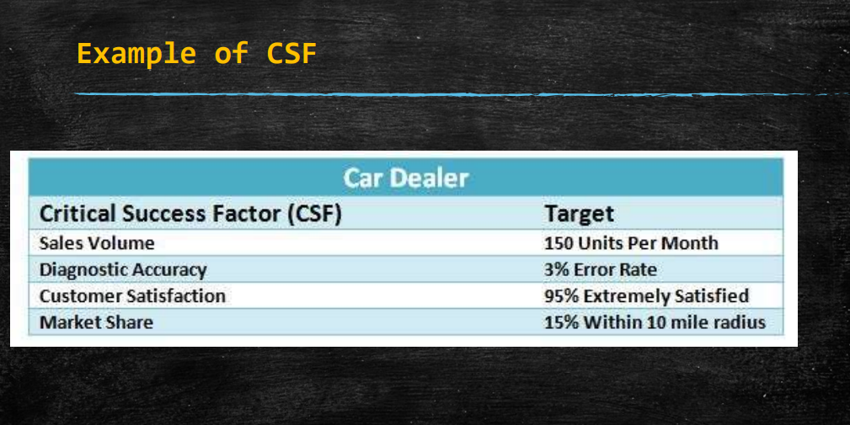

Slide 35
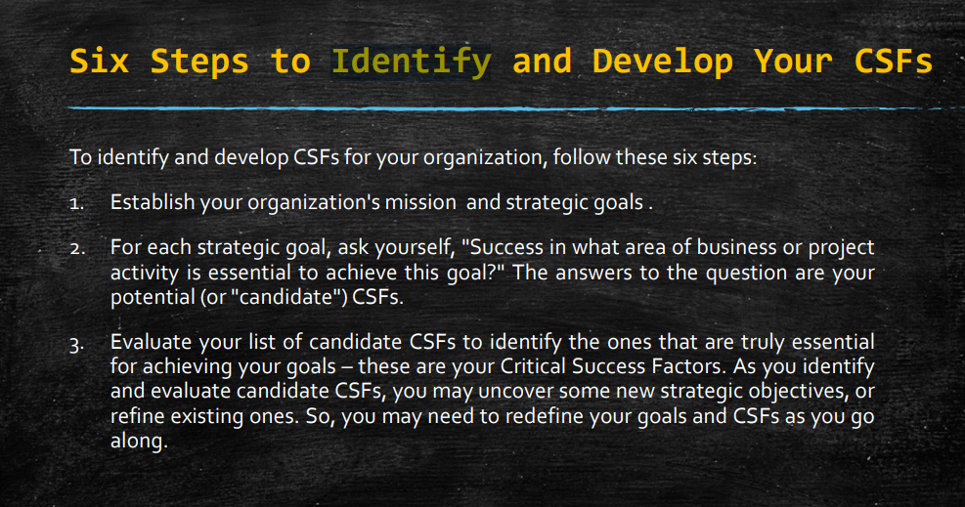

Slide 36
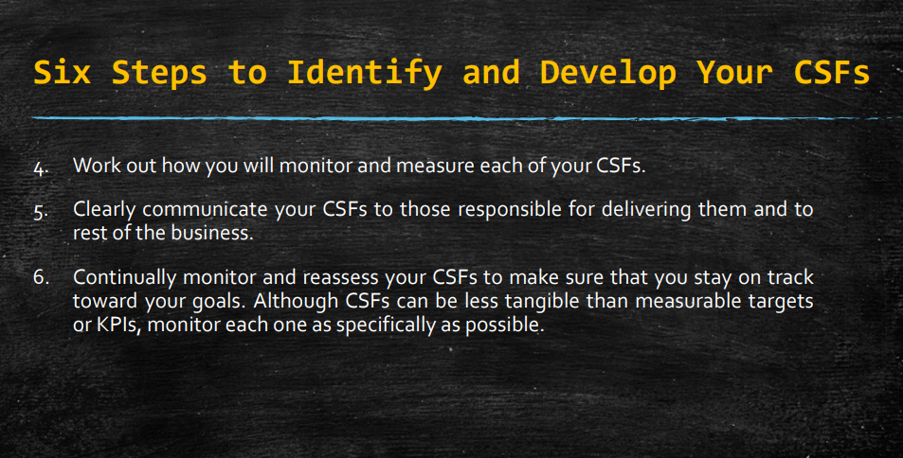

Slide 37
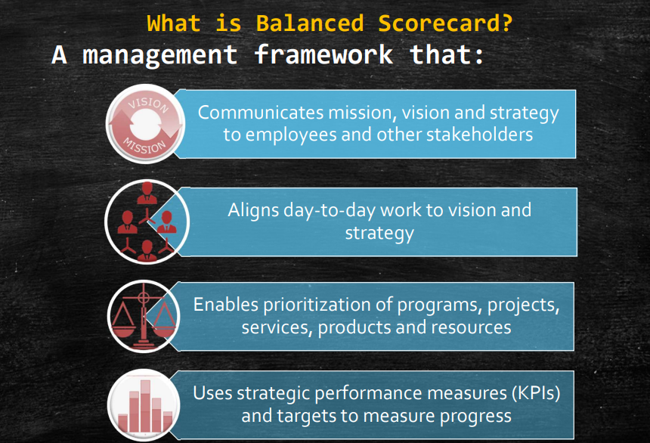

Slide 38
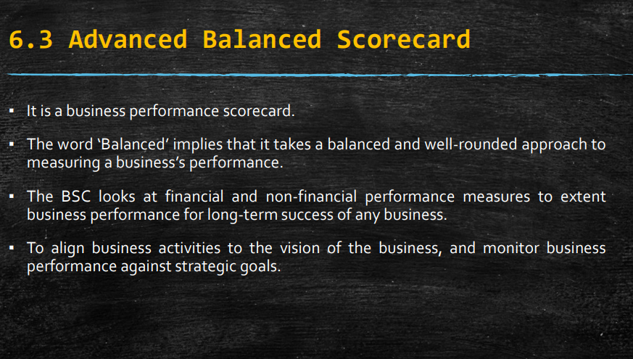

Slide 39
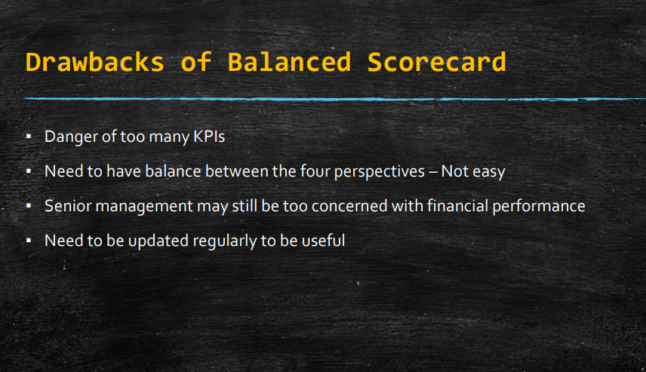

Slide 40
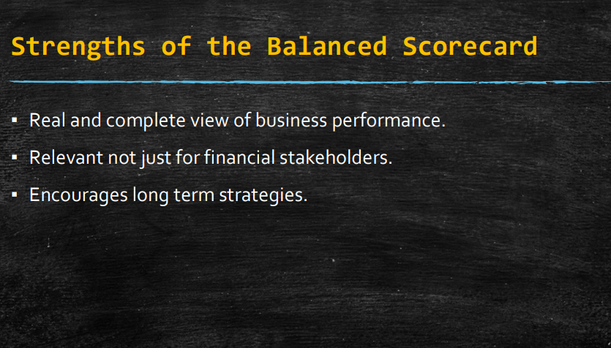

Slide 41
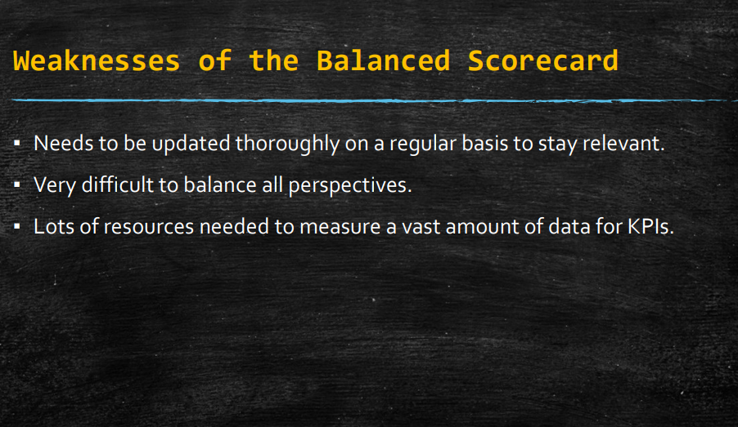

Slide 42
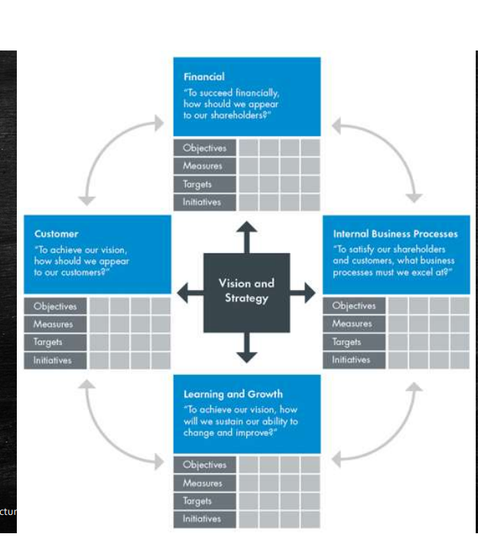

Slide 43
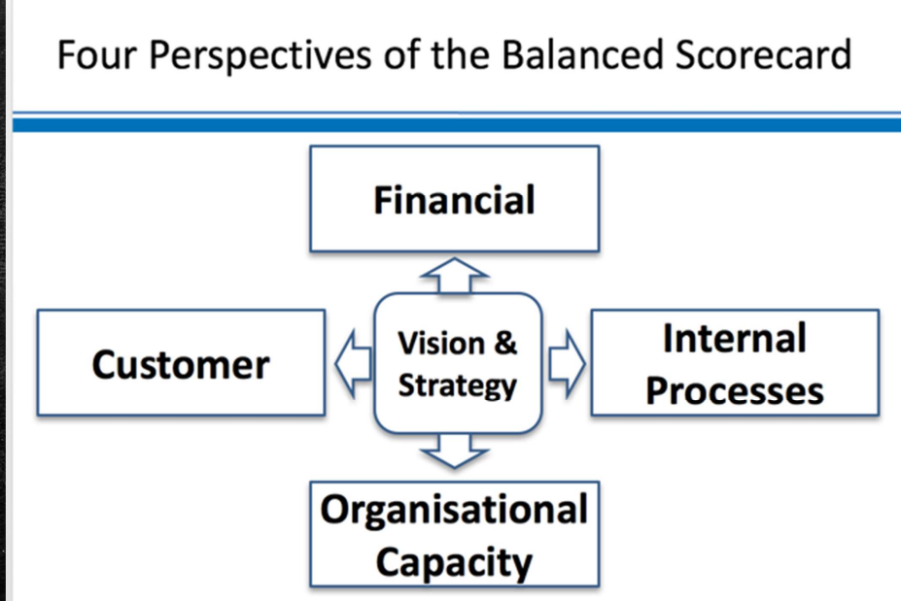

Slide 44
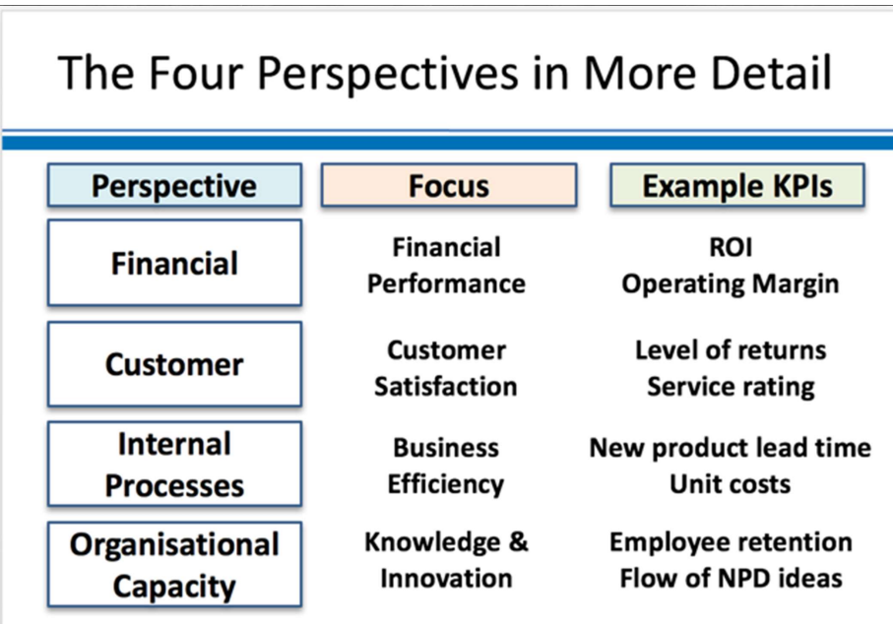

Slide 45
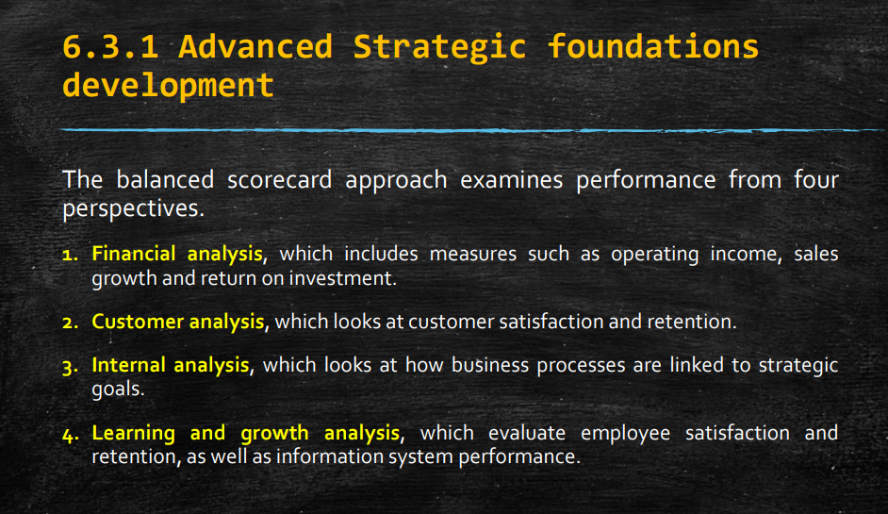

Slide 46
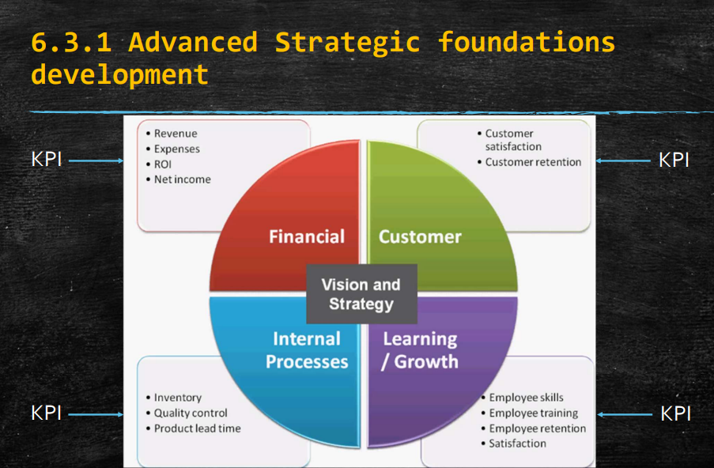

Slide 47
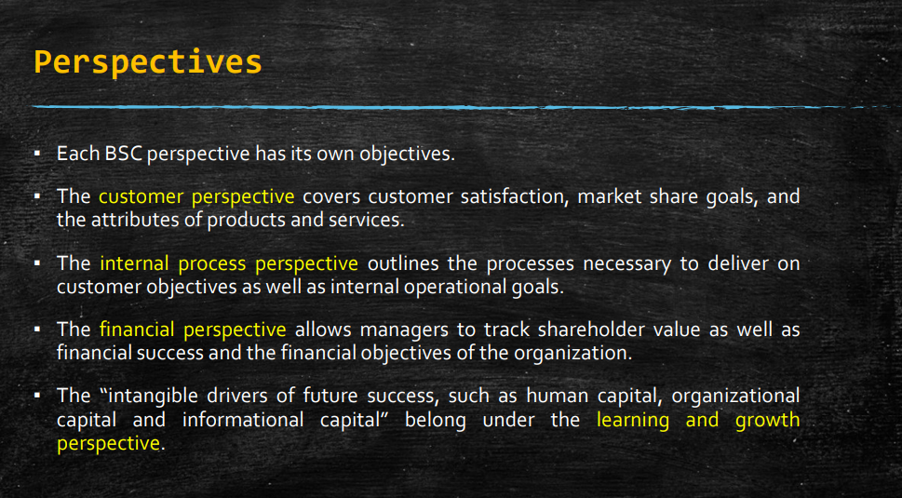

Slide 48
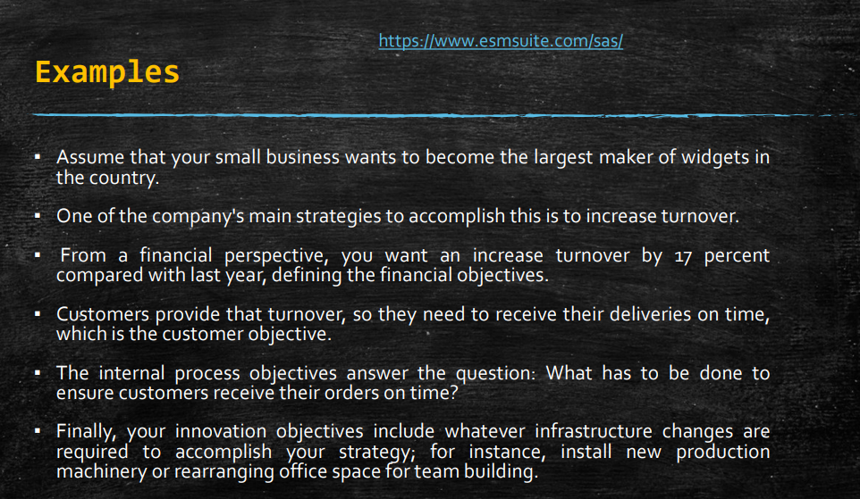

Slide 49
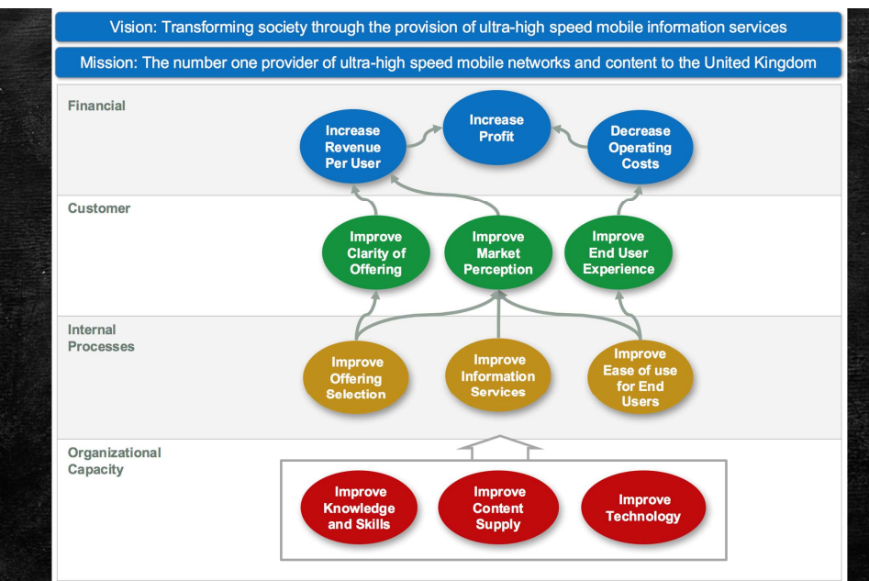

Slide 50
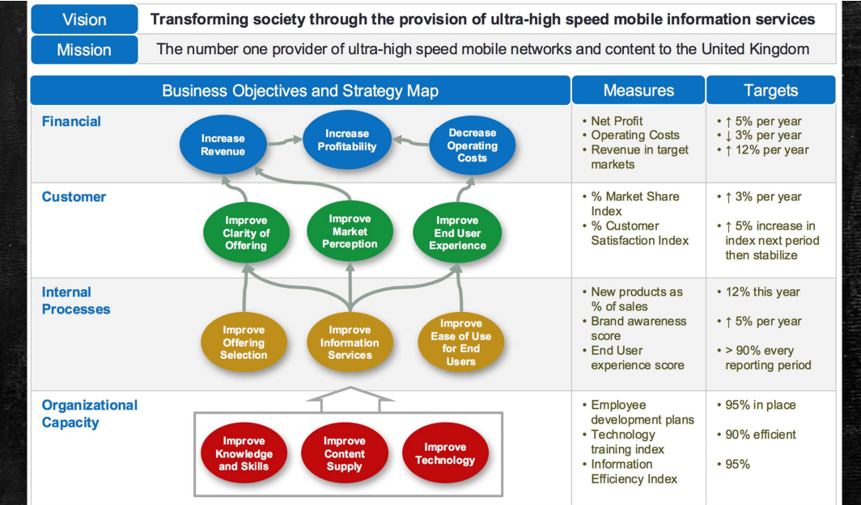

Slide 51
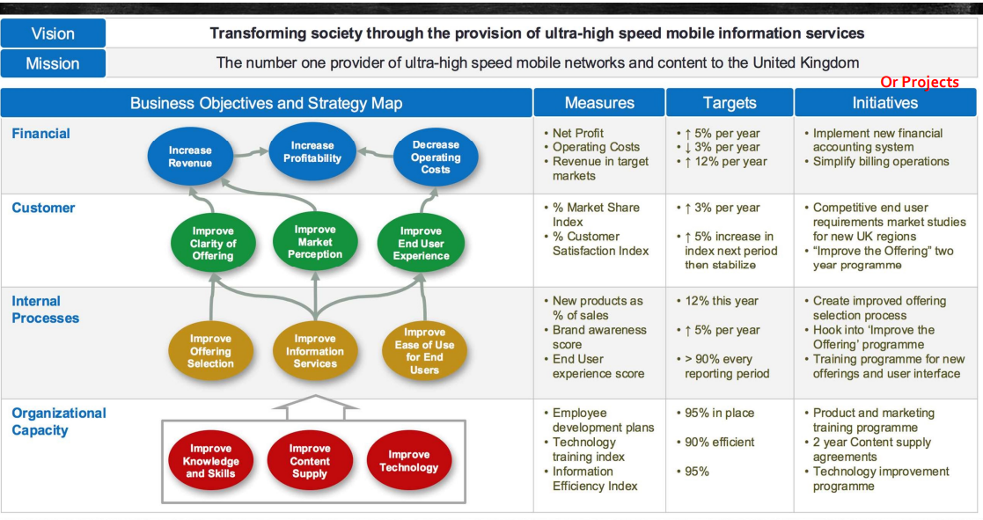

Slide 52
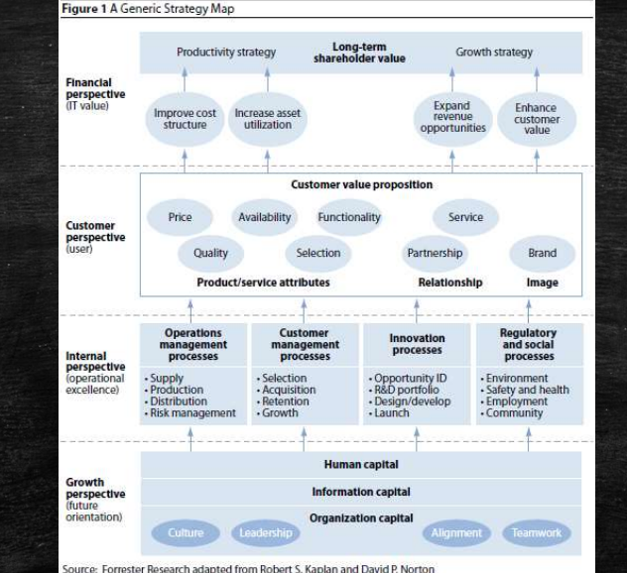

Slide 53
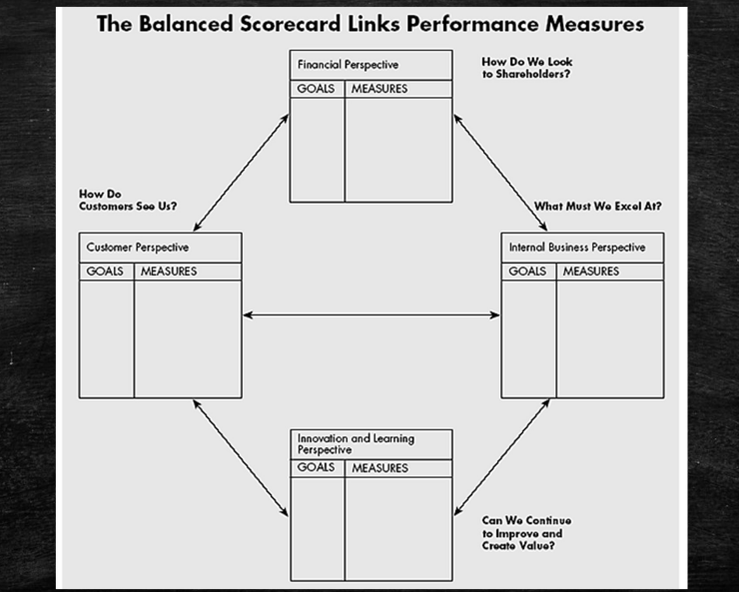

Slide 54
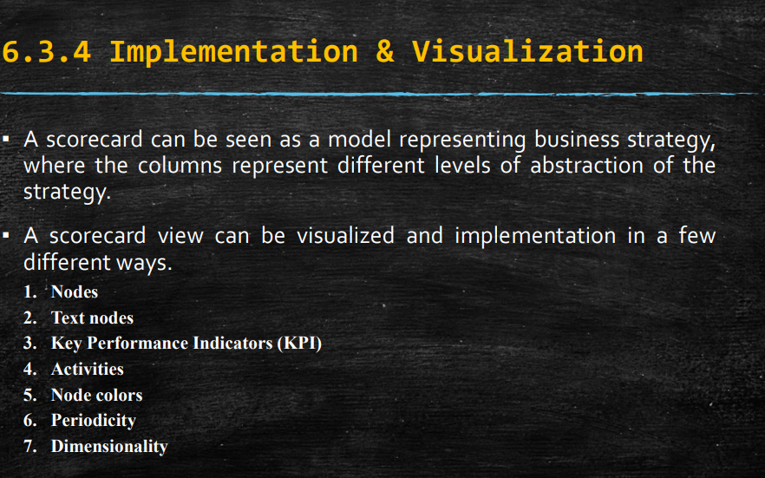

Slide 55
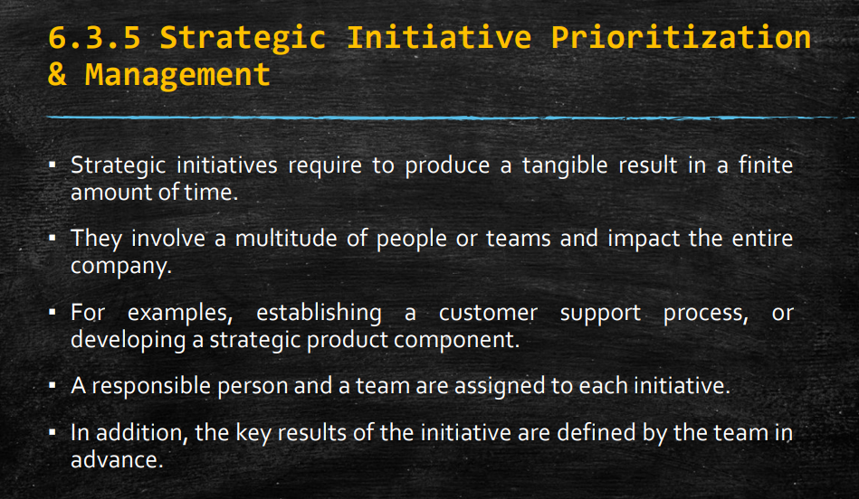

Slide 56
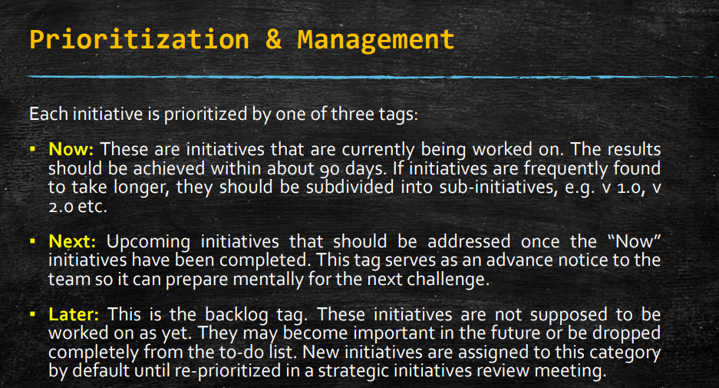

Slide 57
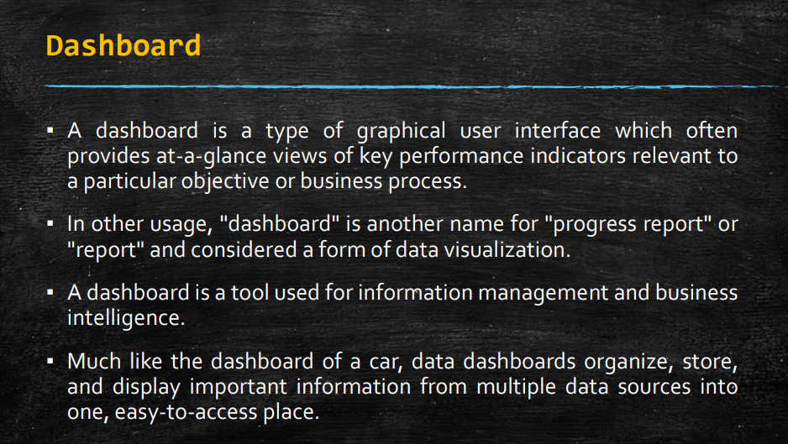

Slide 58
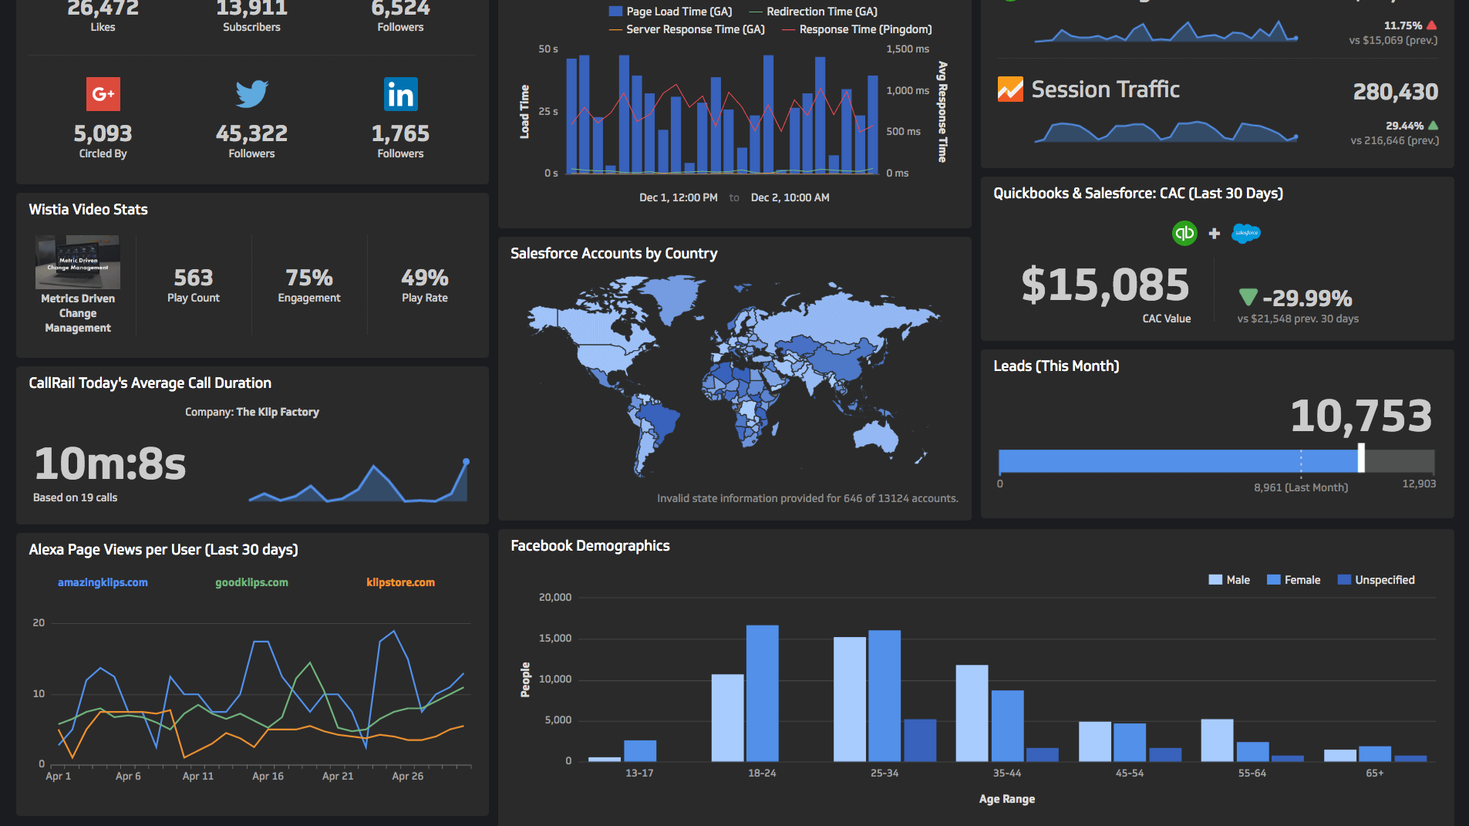

Slide 59
Dashboard
A dashboard in information systems is a visual interface that provides at-a-glance views of key performance indicators (KPIs) and other relevant data points for a particular objective or business process.
Dashboards are used to monitor the performance, trends, and outcomes of various aspects of an organization in real-time.
Need for Dashboards
Real-Time Data Monitoring:
Example: An engineering college’s administration can use a dashboard to monitor real-time data on student attendance, course enrollments, and faculty performance.
Need: Allows for timely interventions and decision-making, ensuring that any issues are addressed promptly.
Enhanced Decision-Making:
Example: A manufacturing company can use a dashboard to track production metrics, such as units produced per hour, defect rates, and machine downtime.
Need: Provides managers with the necessary information to make informed decisions that can optimize production processes and reduce costs.

Slide 60
Dashboard
3. Performance Tracking:
Example: A sales team can use a dashboard to monitor sales targets, conversion rates, and customer acquisition costs.
Need: Helps in setting realistic targets, tracking progress, and identifying areas needing improvement.
4. Data Consolidation:
Example: An HR department can use a dashboard to consolidate data from various sources, such as employee attendance, training completion rates, and employee satisfaction scores.
Need: Simplifies data management by bringing together disparate data sources into a single, coherent view.
5. Transparency and Accountability:
Example: A project management team can use a dashboard to track project milestones, budget usage, and resource allocation.
Need: Increases transparency and accountability by making it clear who is responsible for what and how resources are being used.

Slide 61
Example of a Dashboard in an Engineering College Academic Performance Dashboard
Academic Performance Dashboard
Purpose: To monitor and analyze the academic performance of students and the effectiveness of faculty members.
Key Components:
Student Performance Metrics:
GPA Distribution: Visual representation of the GPA distribution across different departments and courses.
Attendance Rates: Track student attendance rates to identify patterns and potential issues.
Exam Scores: Monitor average exam scores by subject, department, and individual student progress.
Faculty Performance Metrics:
Teaching Evaluations: Aggregate scores from student evaluations of faculty members.
Research Output: Track the number of publications, research grants, and other scholarly activities.
Course Completion Rates: Measure the rate at which students complete courses successfully.
Enrollment Metrics:
Course Enrollments: Number of students enrolled in each course.
Dropout Rates: Track the number of students dropping out and identify reasons.
New Admissions: Monitor the number of new admissions each semester.
Resource Utilization:
Library Usage: Track the usage of library resources, including book checkouts and online resource access.
Laboratory Utilization: Monitor the usage of laboratory equipment and facilities.

Slide 62
Visualization Tools:
Bar Charts: For comparing faculty performance metrics.
Line Graphs: To show trends in student performance over time.
Pie Charts: For distribution of GPA or attendance rates.

Slide 63
Dashboard Example: Project Management Dashboard
Purpose: The project management dashboard in a software company is designed to provide real-time visibility into project progress, resource allocation, and key performance indicators (KPIs) essential for successful project delivery.
Key Components:
Project Status Overview:
Need: To monitor the status of ongoing projects and identify potential bottlenecks or delays.
Example: Visual representation of project timelines, milestones achieved, and upcoming deadlines.
Resource Allocation:
Need: To ensure optimal allocation of resources (developers, testers, designers) across projects.
Example: Pie chart showing the distribution of resources by project or department, highlighting any overallocation or underutilization.
Task Progress and Burndown Charts:
Need: To track progress against planned tasks and ensure projects stay on schedule.
Example: Burndown charts displaying remaining work versus time, helping teams visualize if they are on track to meet deadlines.

Slide 64
Dashboard Example: Project Management Dashboard
4. Bug and Issue Tracking:
Need: To manage and prioritize reported bugs and issues that may impact project delivery.
Example: Metrics on open bugs, resolved bugs, average time to resolution, and severity levels.
5. Customer Feedback and Satisfaction:
Need: To gauge customer satisfaction and feedback on released products or updates.
Example: Net Promoter Score (NPS) trends, customer support ticket volume, and resolution times.
6. Financial Metrics:
Need: To monitor project budgets, costs, and profitability.
Example: Budget utilization charts, project revenue versus expenses, and profitability margins.

Slide 65
Need
Need for the Project Management Dashboard in a Software Company
Real-Time Monitoring: Software projects often have tight deadlines and require constant monitoring to ensure they stay on track. The dashboard provides real-time updates on project status and potential issues.
Example: If a critical milestone is behind schedule, the project manager can immediately identify the cause (e.g., resource constraints or technical challenges) and take corrective actions.
Resource Optimization: Effective resource allocation is crucial for maximizing productivity and meeting project deadlines without overburdening team members.
Example: The dashboard can highlight instances where a team member is assigned to multiple high-priority tasks simultaneously, allowing managers to redistribute workload or adjust project timelines accordingly.

Slide 66
Need
Performance Evaluation: KPIs such as task completion rates, bug resolution times, and customer satisfaction scores help in evaluating project performance and identifying areas for improvement.
Example: By analyzing historical data on bug resolution times, the team can implement strategies to reduce the average time to resolution, thereby improving overall customer satisfaction.
Decision-Making Support: Data-driven insights from the dashboard enable informed decision-making at various levels, from tactical adjustments in project planning to strategic resource allocation.
Example: Based on financial metrics displayed on the dashboard, senior management can decide whether to invest additional resources in a project showing promising profitability or to reallocate resources from a project with declining profitability.
Enhanced Communication: Dashboards facilitate transparency and collaboration by providing a centralized platform where stakeholders can access up-to-date project information and collaborate effectively.
Example: During stakeholder meetings, the project manager can use the dashboard to present progress reports and discuss potential risks or opportunities, fostering constructive dialogue and alignment on project goals.

